Slide 1
Network Assurance
Learning Outcomes:
Network Diagnostic tools: ping, traceroute, syslog and SNMP
Debugging
NetFlow and Flexible NetFlow
Switched Port Analyzer (SPAN) : SPAN, RSPAN and ERSPAN
IP SLA
Cisco DNA Centre Assurance

Slide 2
1. Network Diagnostic Tools
Ping : One of the most underrated tool in network engineering.
Steps to follow when troubleshooting network reachability issues:
Gather the facts. Such as IP address of the remote site router that cannot reach headquarter.
Test reachability by using ping command.
Record the outcome of the command and move on to next step.
If ping is successful, its not the basic reachabiltiy issue.
If unsuccessful then the issue could be related to interface issue, routing issue, ACL or intermediate firewalls.
Notes:
Linux Ping man page

Slide 3
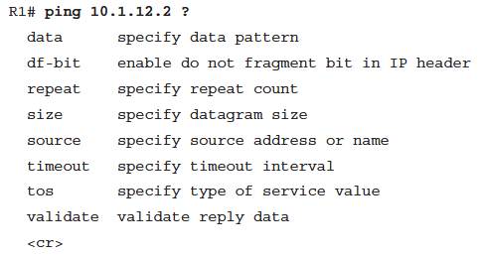
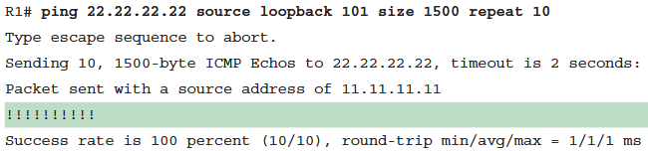
1. Network Diagnostic Tools
Extended Ping : Customize ping to overrule common network issues.
Validating if a change in network resolves the network issue can be done by sending continuous or long ping using 'repeat' and checking the reachability.
Different sizes of packets can be sent using 'size' to test path MTU with df-bit set.It can also be used to test QoS policies.
Source of ping packets should be set appropriately using 'source' to test reachability between two specific interfaces of routers.
Below is an example ping with all these fields set.

Slide 4
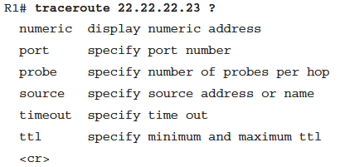
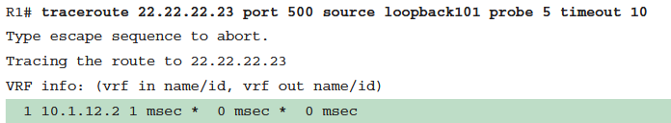
1. Network Diagnostic Tools
Traceroute : It is used to find out how far the packet travels and the path it takes.
Default traceroute settings maximum TTL/hops 30, 3 probes per hop,5 seconds timeout, UDP protocol and port 33434.
Most common unsuccessful traceroute reason is missing route or interface down.
Traceroute sends 'destination host unreachable' message with !H means that there is route to the destination network but specific ip is not available.
Traceroute also offers extended options like ping.
Default protocol and port can be changed to bypass firewalls/ACLs blocking ICMP.
Notes:
Linux Traceroute man page

Slide 5
2. Debugging
Debugging :
Live debugging is helpful but resource intensive
Thus, test in lab before turning on debugging on production environment.
Turn off live debugging using 'undebug all' command.
Conditional Debugging :
Conditional debugging can be used to limit the number of messages that appear on screen.
Thus, it also helps to minimize the resource usage while debugging.
Conditional debugging helps to limit the scope of messages and debug issues in turn.

Slide 6
2. Debugging
Conditional Debugging : Common method of conditional debugging is to create ACL to filter traffic first and then apply the ACL during debug command.
Example:
access-list 100 permit ip any 192.168.14.0 0.0.0.255
access-list 100 permit ip 192.168.14.0 0.0.0.255 any
debug ip packet 100
This debugs/shows all the ip packets destined to and originated from 192.168.14.0/24 network.
Another common method of conditional debugging is to debug interface. Which is applied as inner condition to debug commands.
Example:
debug interface loopback0
debug ip packet 100
This shows packets from ACL 100 AND any packets to and from loopback0 interface.
To remove interface debugging as condition, it needs to be explicitly removed with 'undebug interface loopback0'
'Undebug all' does not remove debugging from interface.
Notes:
Debugging OSPF lab

Slide 7
1. SNMP
Simple Network Management Protocol(SNMP)
SNMP sends unsolicited messages of network events from network device(agent) to SNMP collector or Network Management System (NMS) (server).
The events for which the messages are sent is defined in Management Information Base (MIB).
SNMP version comparison
Version | Level | Authentication Type | Encryption | Result
SNMPv1 | NoAuthNoPriv | Community string | No | Uses community string match
SNMPv2c | NoAuthNoPriv | Community string | No | Uses community string match
SNMPv3 | NoAuthNoPriv | Username | No | Uses username match to authenticate
SNMPv3 | AuthNoPriv | MD5 or SHA | No | Uses HMAC-MD5 or HMAC-SHA
SNMPv3 | AuthPriv (crypto engine) | MD5 or SHA | DES or AES | Allows for User-based Security Model (USM) for combination of HMAC authentication and encryption
Notes:
SNMP_SNMPv3_Syslog_Netflow_lab

Slide 8
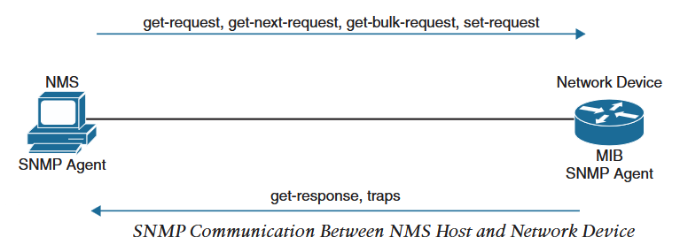
1. SNMP
SNMPv1 and SNMPv2 uses ACL and community string/password to control which SNMP Manager can talk to Agents.
Community strings can be read-only (RO) allowing polling of devices
Read/Write (RW) allows polling and pushing information or configuration to devices.
Below table shows operations for SNMPv2c
Operation | Description
get-request | Retrieves value from a specific variable
get-next-request | Retrieves value for a variable within a table
get-bulk-request | Retrieves large block of data, such as multiple rows of a table, that would otherwise require many smaller blocks.
get-response | Replies to get-request, get-next-request and set-request sent by NMS
set-request | Stores a value in particular variable
trap | Sends unsolicited message from Agent to Manager when an event occurs.
Notes:
SNMP_SNMPv3_Syslog_Netflow_lab

Slide 9
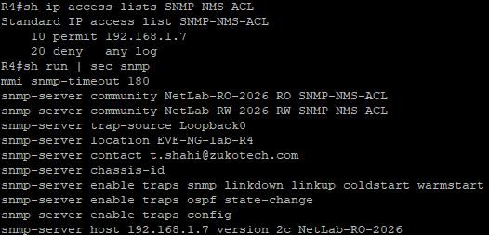
1. SNMP
For a device to be polled and send traps, below should be configured:
Define SNMP host or NMS to send traps to
Create access-list to restrict access via SNMP
Define RO community string/password
Define RW community string/password
Define SNMP location
Define SNMP contact
For network device to send traps, it must be enabled on the device with command 'snmp-server enable traps'.
This enables all traps including unnecessary to network admins.
Types of traps that can be enabled can be viewed with context-sensitive help command.
snmp-server enable traps ?
Notes:
SNMP_SNMPv3_Syslog_Netflow_lab

Slide 10
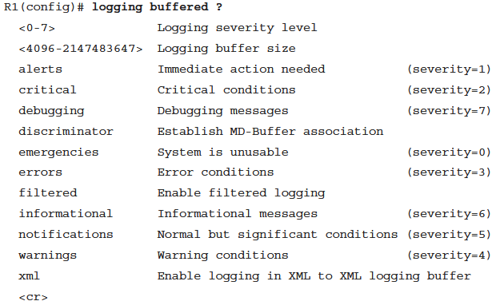
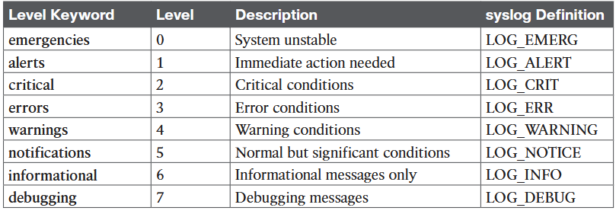
Syslog
System logs (Syslog) are the event driven messages generated by OS.
These messages can be directed to console (default), logging buffer or off-box collector.
Different types of messages can be sent to different file (console, logging buffer, off-box collector) simultaneously.
For syslog messages to be relevant, system time must be synchronized (NTP/PTP).
Below is the syslog messages severity levels:
To log syslog messages to logging buffer follow below steps:
Enable logging to the buffer
Set syslog traps severity level
Increase logging buffer size
Cisco IOS logging buffered context-sensitive help menu
Notes:
SNMP_SNMPv3_Syslog_Netflow_lab

Slide 11
Syslog
Example : Send annoying debug messages to logging buffer instead of console.
R1(config)#logging buffered debugging
R1(config)#logging buffered 100000
R1(config)#no logging console
R1#debug ip ospf hello
R1#show logging
R1# undebug all
To log to off-box collector, follow below steps:
Enable logging to host (ip address of host)
R1(config)#logging host 192.168.14.100
Set severity level of syslog messages to send to host
R1(config)#logging trap 7
Off-box logging uses UDP port 514
Notes:
SNMP_SNMPv3_Syslog_Netflow_lab

Slide 12
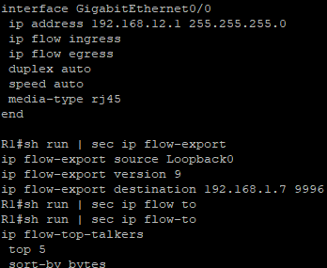
4. NetFlow
NetFlow Components:
NetFlow Data Capture : Captures traffic statistics
Traffic statistics are captured in device memory cache.
NetFlow Data Exporter : Exports to collector
NetFlow captures traffic on ingress and egress.
Traffic is collected/captured based on flow.
A flow is a unidirectional traffic stream that contains combination of following key fields(7 tuples):
Destination IP
Source IP
Destination Port
Source Port
Type of Service (ToS)
Layer 3 protocol type
Input logical interface
Notes:
SNMP_SNMPv3_Syslog_Netflow_lab

Slide 13
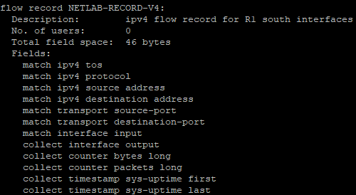
4. Flexible NetFlow
Similar to NetFlow but modularity in configuration using :
Flow Records: Matches key and non-key fields to record
Flow Monitors: Applied to the interface to perform traffic monitoring.
Flow Exporters: Exports NetFlow version 9 data from Flow Monitor cache to a host or flow collector.
Flow Samplers: Sample only particular traffic.
Custom flow records can be created by using match and collect command.
Match command is used to match key field and collect command to match non-key field.
Show run flow record shows custom flow records
Show flow record record-name shows 'record-name' flow record.
Show flow record shows all pre-defined and custom flow records.
Steps to create custom flow record:
Define flow record name
Set useful description
Set match criteria for key field
Define non-key fields to be collected.
Notes:
SNMP_SNMPv3_Syslog_Netflow_lab

Slide 14
4. Flexible NetFlow
Create Flow Exporter:
Define the flow exporter name
Set a useful description of the flow exporter
Specify the destination of the flow exporter
Specify NetFlow version to be exported
Specify the UDP port
R1#sh run flow exporter
Current configuration:
!
flow exporter NETLAB-EXPORTER
description Export to Linux NMS
collector destination 192.168.1.7
source Loopback0
transport udp 9996
template data timeout 60
Notes:
SNMP_SNMPv3_Syslog_Netflow_lab

Slide 15
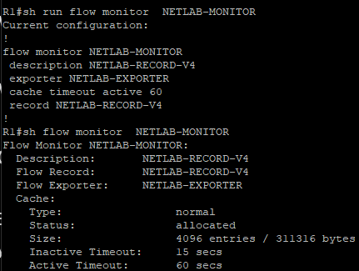
4. Flexible NetFlow
Create Flow Monitor:
Each flow monitor needs a flow record to be assigned to it.
Each flow monitor has it's own cache as per the flow record.
Steps to create flow monitor:
Define flow record name
Set useful description (map back to flow record)
Specify flow record to be used
Set flow monitor cache time out for active connections (export every 60 seconds)
Specify flow exporter to be used
Show run flow monitor and show flow monitor monitor-name shows flow monitor
Final step to use Flexible NetFlow is to apply to interfaces.
It can be applied ingress, egress or both.
Notes:
SNMP_SNMPv3_Syslog_Netflow_lab

Slide 16
4. SPAN
Traffic mirroring techniques:
Using splitter in fibre optics to split traffic from actual destination to traffic analyzer
Configure network devices to mirror data plane traffic to send to local or remote host.
Inserting switch in traffic path to mirror traffic and send to traffic analyzer
Switched Port Analyzer : SPAN does above 2 and 3 with below variety:
Local SPAN: Send mirrored traffic to host attached to local port.
Remote SPAN (RSPAN): Mirror traffic on remote switch and forward it to local switch port that has traffic analyzer attached to it (Layer 2 forwarding(Switching)).
Encapsulated RSPAN (ERSPAN): Mirror traffic on remote switch and forward it to local switch port that has traffic analyzer attached to it (Forwarding in layer 3(Routing)).
Notes:
EVE-NG Switching SPAN-RSPAN Lab

Slide 17
4. SPAN
Local SPAN: All configuration occur in single switch. Destination of mirrored traffic can be one or more ports. Source can be only one of the below:
One or more switch ports
A port channel (EtherChannel)
A VLAN, traffic received for a specific VLAN, not included SVI (such as VLAN 10 only on trunk port).
Consideration for Local SPAN:
Most switches support at least two SPAN sessions
Destination ports cannot be shared between two SPAN sessions, whereas source port can be reused.
Source can be switched or routed port.
Destination port can be saturated if source port bandwidth is much higher than the destination port.
Specifying Source ports:
Global configuration command :
monitor session
session-id source {interface interface-id | vlan vlan-id} [rx | tx | both]
Session-id is used to corelate source port and destination port of a session.
One or more interfaces or VLANS can be specified with delimiting characters (, or -).
Default traffic direction is both, can be rx or tx only.
VLANs can be filtered on the capture with the command: monitor session session-id filter vlan vlan-range
Notes:
{ } : Mandatory options , [ ] : Optional options

Slide 18
4. SPAN
Specifying destination port:
Global configuration command:
monitor session session-id destination interface interface-id [encapsulation
{dot1q [ingress {dot1q vlan vlan-id | untagged vlan vlan-id | vlan vlan-id}|
replicate [ingress {dot1q vlan vlan-id | untagged vlan vlan-id]}} | ingress]
Default behavior of SPAN on destination port is to mirror traffic without including dot1q tags or other layer 2 protocols (STP, VTP,DTP etc.)
Using encapsulation replicate option of above command copies all those information.
monitor session session-id destination interface interface-id [encapsulation replicate]
SPAN destination port only receives SPAN traffic and drops ingress traffic.
Ingress traffic are packets send to and from attached host other than SPAN traffic (such as RDP or SSH).
monitor session session-id destination interface interface-id ingress {dot1q vlan vlan-id | untagged vlan vlan-id}
dot1q vlan vlan-id tags with vlan-id and untagged vlan vlan-id assigns ingress traffic to vlan-id.
Notes:
{ } : Mandatory options , [ ] : Optional options

Slide 19
4. RSPAN
RSPAN: Source port and destination port are in different location (Switches).
Recommended to create a separate RSPAN vlan for SPAN traffic only.
MAC addresses are not learned on any switchport associated to RSPAN vlan.
All trunk ports in between source and destination switchport should allow RSPAN vlan.
Example configuration:
On both source and destination switch:
vlan 99
name RSPAN-VLAN
remote-span
On source switch:
monitor session 1 source interface Gi0/3
monitor session 1 destination remote vlan 99
On destination switch:
monitor session 1 source remote vlan 99
monitor session 1 destination Gi1/0
To verify : Show monitor session remote

Slide 20
4. ERSPAN
ERSPAN provides ability to monitor traffic at one area of the network and send it to the traffic analyzer at another area over a layer 3 network.
Not supported on all platform.
Specifying source and destination ports:
Global config mode:
monitor session span-session-number type erspan-source
description description
source { interface type number | vlan vlan-ID } [ , | - | both | rx | tx ]
filter { ip { standard-access-list | expanded-access-list | acl-name } | ipv6 { access-group acl-name } | vlan vlan-ID }
no shutdown
destination
ip address ip-address
erspan-id erspan-id
origin ip address ip-address
Exit
erspan{ tos tos-value | ttl ttl-value }
Verify using:
show monitor session erspan-source session
SW4(config)# monitor session 1 type erspan-source
SW4(config-mon-erspan-src)# description SOURCE-PC-D-TRAFFIC
SW4(config-mon-erspan-src)# source interface GigabitEthernet 1/0/4 rx
SW4(config-mon-erspan-src)# filter vlan 34
SW4(config-mon-erspan-src)# no shutdown
SW4(config-mon-erspan-src)# destination
SW4(config-mon-erspan-src-dst)# ip address 10.123.1.100
SW4(config-mon-erspan-src-dst)# erspan-id 2
SW4(config-mon-erspan-src-dst)# origin ip address 10.34.1.4
SW4(config-mon-erspan-src)# exit
SW4(config)# erspan ttl 32
SW4(config)# end
SW4# show monitor session erspan-source session
Notes:
{ } : Mandatory options , [ ] : Optional options No lab, only certain images support ERSPAN (Network Advantage or DNA Centre license required)

Slide 21
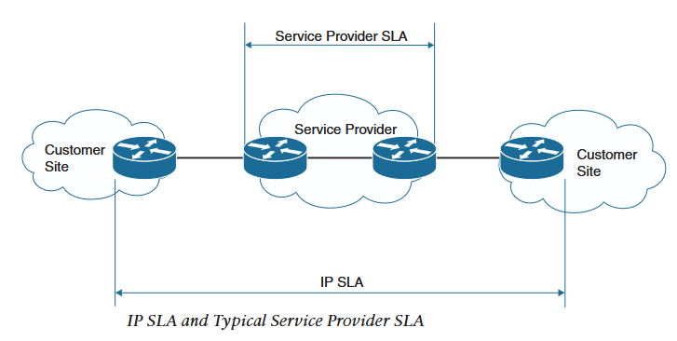
5. IP SLA
IP Service Level Agreement (IP SLA)
Tool to continuously monitor various aspects of the network.
Following can be monitored with IP SLA:
Delay (both round-trip and one way)
Jitter (directional)
Packet loss (directional)
Packet sequencing (ordering)
Path (Per hop)
Connectivity (directional)
Server or website download time
Voice quality scores
IP SLA configuration steps:
Specify IP SLA operation number
ip sla operation-number
Specify what is being monitored, command varies based on monitored object.
icmp-echo {destination-ip-address |destination-hostname} [source-ip {ip-address | hostname} | source-interface interface-name]
Specify the frequency of IP SLA operation
frequency seconds
Schedule the IP SLA operation
ip sla schedule operation-number [life {forever | seconds}] [start-time {[hh:mm:ss] [month day | day month] | pending | now | after hh:mm:ss}] [ageout seconds] [recurring]
Verify using:
show ip sla configuration operation-number
show ip sla statistics operation-number
Notes:
{ } : Mandatory options , [ ] : Optional options

Slide 22
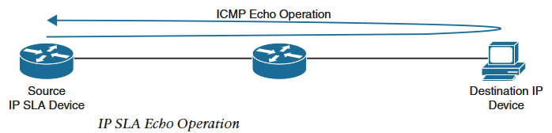
5. IP SLA
IP SLA ICMP-echo monitoring:
R1(config)# ip sla 1
R1(config-ip-sla)# icmp-echo 192.168.14.100 source-interface Loopback0
R1(config-ip-sla-echo)# frequency 300
R1(config-ip-sla-echo)# end
R1(config)# ip sla schedule 1 life forever start-time now
R1# show ip sla configuration 1
IP SLA HTTP GET destination monitoring:
HTTP GET Probe:
http {get | raw} url [name-server ip-address] [version version-number] [source-ip {ip-address | hostname}] [source-port port-number] [cache {enable | disable}] [proxy proxy-url]
R1(config)# ip sla 2
R1(config-ip-sla)# http get http://192.168.1.7 : 8080
R1(config-ip-sla-http)# frequency 90
R1(config-ip-sla-http)# end
R1(config)# ip sla schedule 2 start-time now life forever
Notes:
{ } : Mandatory options , [ ] : Optional options

Slide 23
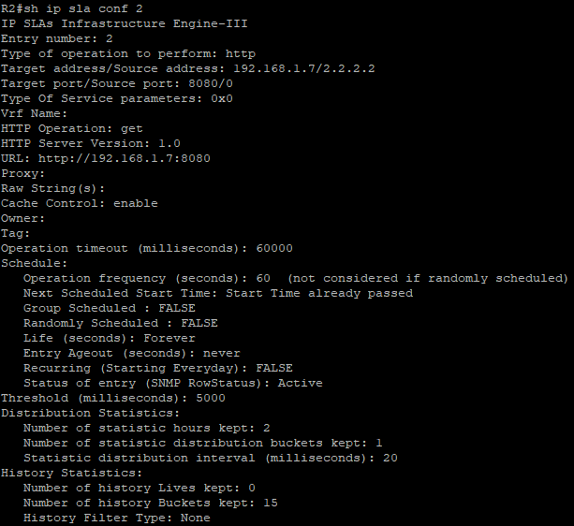
5. IP SLA
To run IP SLA HTTP GET to a Ubuntu host:
Start a test http server with python3 on ubuntu host:
sudo python3 –m http.server 8080
R2#sh ip sla stat 2
IPSLAs Latest Operation Statistics
IPSLA operation id: 2
Latest RTT: 14 milliseconds (NoConnection/Busy/Timout if not successful)
Latest operation start time: 13:12:00 UTC Wed Jul 8 2026
Latest operation return code: OK (No connection if not successful)
Latest DNS RTT: 0 ms
Latest TCP Connection RTT: 7 ms
Latest HTTP Transaction RTT: 7 ms
Number of successes: 1
Number of failures: 2
Operation time to live: Forever

